Slide 1

Modern Programming Tools And Techniques-I
Lecture 9: This, Super & Final Keywords

Slide 2
Contents
Object class
super keyword
final keyword
final class
static keyword
this keyword

Slide 3
Object Class
There is one special class, called Object, defined by Java.
All other classes are subclasses of Object. i.e., Object is a super-class of all other classes.
A reference variable of type Object can refer to an object of any other class.
The Object class defines the basic state and behavior that all objects must have.
Arrays are implemented as classes, so a variable of type Object can also refer to any array.
In Object class, getClass( ), notify( ), notifyAll( ), and wait( ) are declared as final.

Slide 4
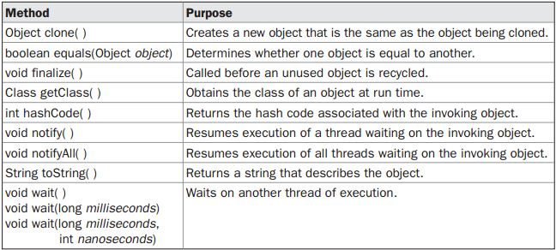
Methods in Object class

Slide 5
‘final’ Keyword
‘final’ keyword is used to:
  declare variables that can be assigned value only once.
  final type identifier = expression;
  prevent overriding of a method.
  final return_type methodName (arguments if any)
  {
  body;
  }
  prevent inheritance from a class.
  final class Class_Name
  {
  class body;
  }

Slide 6
‘super’ Keyword
‘super’ keyword is used to:
  invoke the super-class constructor from the constructor of a sub-class.
  super (arguments if any);
  invoke the method of super-class on current object from sub-class.
  super.methodName (arguments if any);
  refer the super-class data member in case of name-conflict between super and sub-class data members.
  super.memberName;

Slide 7
‘static’ Keyword
used to represent class members
Variables can be declared with the “static” keyword.
static int y = 0;
When a variable is declared with the keyword “static”, its called a “class variable”.
All instances share the same copy of the variable.
A class variable can be accessed directly with the class, without the need to create a instance.
Note: There's no such thing as static classs. “static” in front of class creates compilation error.

Slide 8
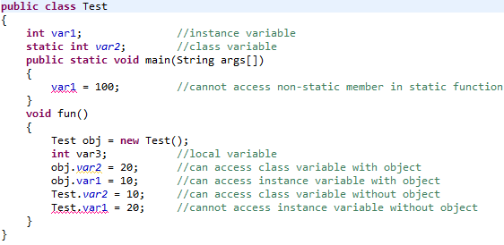
Example

Slide 9
static methods
Methods can also be declared with the keyword “static”.
When a method is declared static, it can be used without creating an object.
class T2 {
static int triple (int n)
{return 3*n;}
}
class T1 {
public static void main(String[] arg)
{
System.out.println( T2.triple(4) );
T2 x1 = new T2();
System.out.println( x1.triple(5) );
}
}

Slide 10
Methods declared with “static” keyword are called “class methods”.
Otherwise they are “instance methods”.
Static Methods Cannot Access Non-Static Variables.
The following gives a compilation error, unless x is also static.
class T2 {
int x = 3;
static int returnIt () { return x;}
}
class T1 {
public static void main(String[] arg) { System.out.println( T2.returnIt() ); }
}

Slide 11
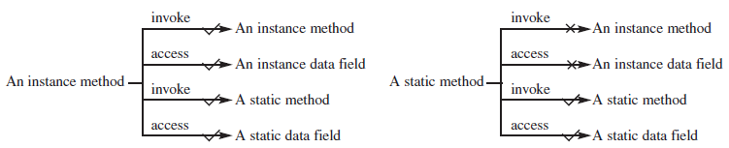
Properties of static & non-static method

Slide 12
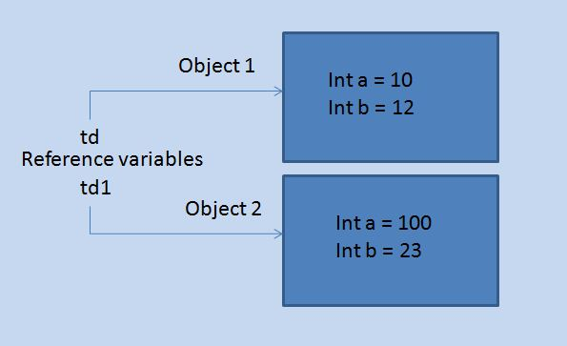
‘this’ Keyword
'this' is used for pointing the current class instance.
Within an instance method or a constructor, this is a reference to the current object — the object whose method or constructor is being called.

Slide 13
class ThisDemo1{
int a = 0;
int b = 0;
ThisDemo1(int x, int y)
{
this.a = x;
this.b = y;
}
public static void main(String [] args)
{
ThisDemo1 td = new ThisDemo1(10,12);
ThisDemo1 td1 = new ThisDemo1(100,23);
System.out.println(td.a);
System.out.println(td.B);
System.out.println(td1.a); System.out.println(td1.B); }
}

Slide 14
Chaining of constructors using this keyword
Chaining of constructor means calling one constructor from other constructor.

Slide 15
class ThisDemo{
public ThisDemo() {
this(10); System.out.println("First Constructor");
}
public ThisDemo(int a) // overloaded constructor
{
this(10,20); System.out.println("Second Constructor");
}
public ThisDemo( int a, int B) // another overloaded constructor
{
this(“Ravi Kant"); System.out.println("Third Constructor");
}
public ThisDemo(String s) // and still another
{
System.out.println("Fourth Constructor");
}
public static void main(String args[]) {
ThisDemo first = new ThisDemo();
}
}

Slide 16
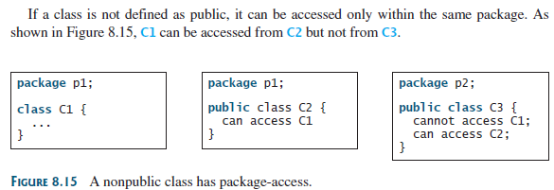
Visibility modifiers Example

Slide 17
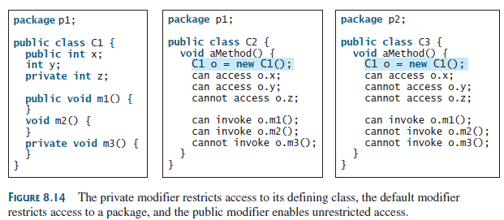
Visibility modifiers Example

Slide 18
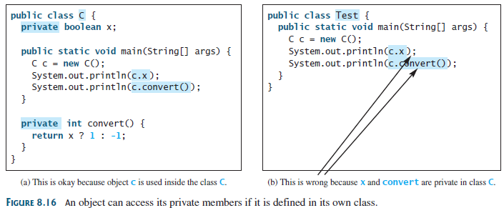
Visibility modifiers Example

Slide 19

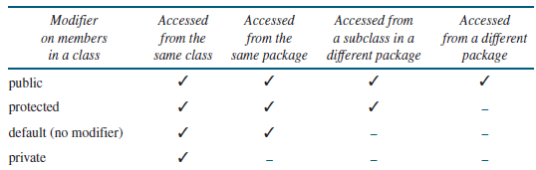
Visibility modifiers

Slide 20


